Slide 1
SURVEILLANCE ROBOT WITH CAMERA MODULE 🤖
22BCE5225 - S R KOUSALYA
22BCE5233 - HARINI L

Slide 2
ABSTRACT:
This presentation introduces an innovative web-controlled surveillance vehicle designed for remote monitoring applications. Equipped with integrated cameras, sensors, and a secure web interface, the system enables users to remotely control the vehicle and perform surveillance operations through a dedicated website. The project focuses on the technical design, user interface, and practical applications of the system, highlighting its potential to enhance remote monitoring, security, and surveillance capabilities across various sectors.

Slide 3
A vehicle with Control through a website and Bluetooth Control Robot with WIFI
The "WiFi Car" is a groundbreaking mobile platform that integrates both website-controlled and Bluetooth-enabled functionalities, revolutionizing remote operation and surveillance capabilities. Equipped with cameras and sensors, this vehicle can be navigated and managed through a secure website interface from any internet-connected device, offering seamless remote control. Simultaneously, its Bluetooth control robot mode allows for direct interaction within a limited range, ensuring flexibility in operation. This fusion of website-based control and Bluetooth connectivity embodies a versatile and adaptable surveillance solution, showcasing the potential for advanced remote monitoring across diverse environments and applications.

Slide 4
PROBLEM STATEMENT:
In modern surveillance systems, the challenge lies in ensuring effective monitoring and security, especially in crowded or complex environments. Traditional surveillance vehicles often face obstacles in their path, hindering their ability to navigate and capture crucial data. These obstacles can include people, vehicles, or various objects, leading to blind spots and compromised security coverage. The inability to avoid obstacles in real-time poses a significant problem, limiting the surveillance system's efficiency and reliability.
SOLUTION AND SOCIAL NEED:
Developing a robust and secure system for real-time surveillance utilizing a camera module integrated into a web-controlled bot, ensuring seamless remote access and efficient monitoring while addressing potential cybersecurity risks and data privacy concerns.
In military and tunnel surveillance scenarios, there's a critical societal need for advanced remote monitoring systems employing web-controlled bots with integrated surveillance camera modules. These systems serve to enhance situational awareness, security, and safety measures in high-risk environments. By deploying such technology, military personnel and security teams can remotely navigate and monitor areas that are inaccessible or hazardous, thereby reducing human risk exposure during reconnaissance missions, tunnel inspections, or security patrols. This innovation addresses the societal imperative of safeguarding lives, securing critical infrastructure, and ensuring effective surveillance in challenging operational settings.

Slide 5
MARKET AND COMPETITORS:
LEGO Mindstorms: LEGO offers programmable robotics kits that allow users to build and control robots. While it may not have all the advanced features, it's a popular choice for educational purposes.
Makeblock: Makeblock provides a range of robotic kits, including those with obstacle avoidance and Bluetooth control features, targeting both education and hobbyist markets.
Robolink: Robolink offers educational robotics kits that include features like obstacle avoidance and programmable modules. They focus on providing learning experiences for students and enthusiasts.
Wonder Workshop: Wonder Workshop produces educational robots like Dash and Cue, which are designed to teach programming and robotics concepts to children. While they may not have the exact specifications mentioned, they operate in a similar educational space.
Arduino-based Robotics Kits: Various companies and individuals create custom Arduino-based robotics kits with obstacle avoidance, Bluetooth control, and voice command capabilities. These cater to the DIY and hobbyist market.

Slide 6
EXISTING PATENTS AND PRODUCTS:
US Patent US20180012554A1 - "Remote Control Robot and Control Method Thereof": This patent covers remote-controlled robots, including those equipped with cameras for surveillance purposes.
US Patent US20190361238A1 - "Automated Surveillance Drone System and Method": While not directly related to ground-based bots, this patent involves drone technology with surveillance capabilities that might share some concepts applicable to ground-based surveillance bots.
US Patent US20190143312A1 - "Method for Remotely Operating Robot and System Thereof": This patent might involve aspects related to remote operation of robots, potentially applicable to surveillance bots controlled via a website interface.

Slide 7
BLOCK DIAGRAM OF BOARD DESCRIPTION:
When Car start Lidar and Colour Sensor send their input to microcontroller. With the received information from Sensors, microcontroller decide to take next decision like Start, Stop, Move Forward, Move Backward, Turn Right, Turn Left, etc. Microcontroller end instruction to the motor driver for controlling motors with respective input taken from sensor. Regulated power supply is connected to the microcontroller as well as motor driver.

Slide 8
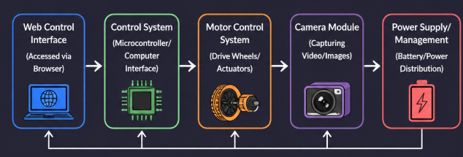
BLOCK DIAGRAM OF BOARD:

Slide 9
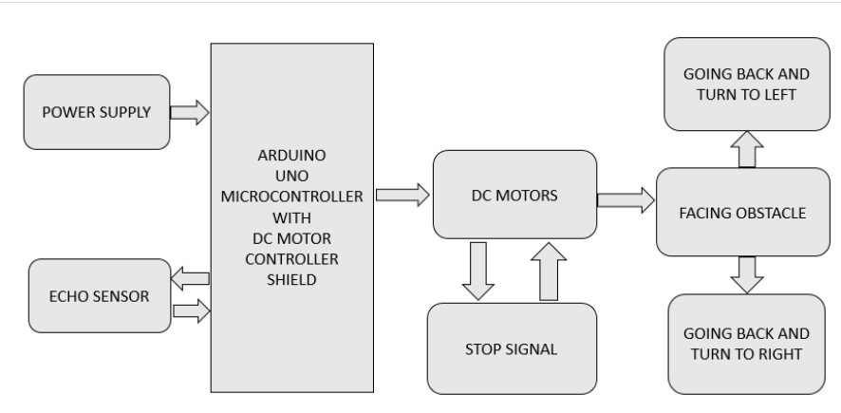
BLOCK DIAGRAM:

Slide 10
HARDWARE SPECIFICATIONS:
Arduino Uno
DC Motor (100 RPM)
Motor driver IC (L298N)
Battery LIPO (1000MAH) 2S
Breadboard
ESP 32 Camera Module and Chassis Board

Slide 11
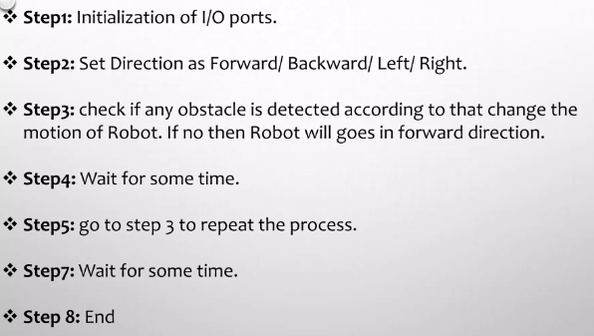
ALGORITHM:

Slide 12
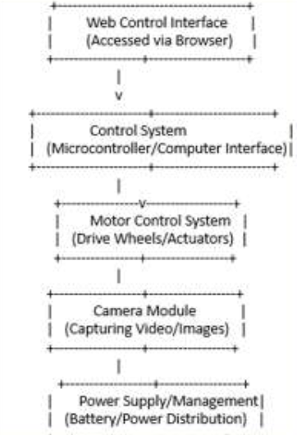
FLOW CHART:

Slide 13
SOFTWARE SPECIFICATIONS :
Arduino Uno IDE Compiler
Programming Language C Compiler﻿

Slide 14
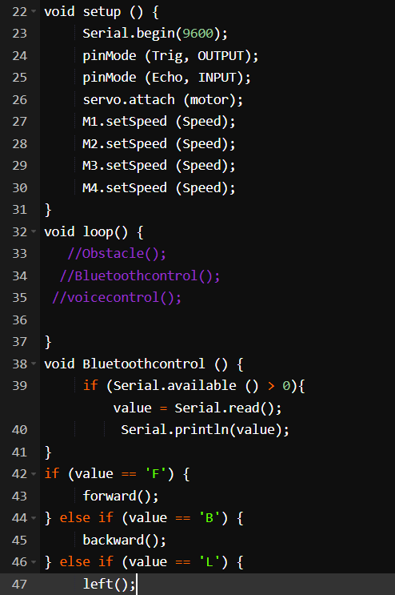
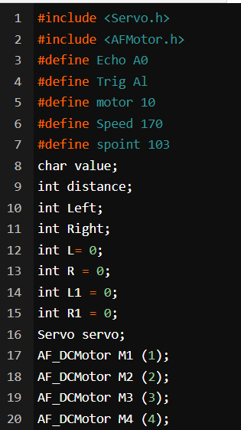
CODE:
https://docs.google.com/document/d/1VZsCXU1laurBLp8iJ4u4rB4JzhDPxQ2wisTZtY0xl58/edit

Slide 15
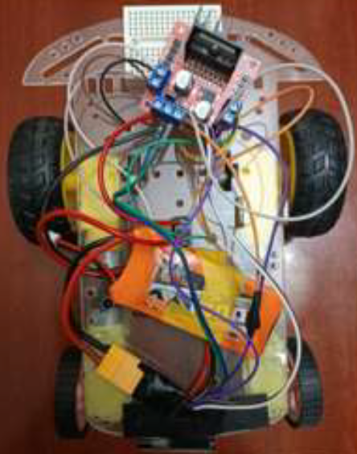
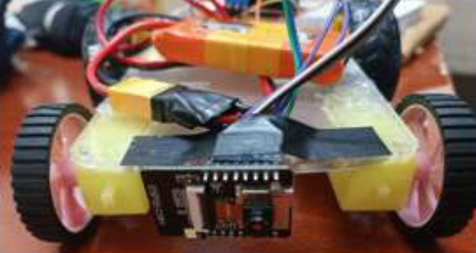
WORKING PROCESS:
https://drive.google.com/file/d/1Qif9rCUmhN914T6JMdDbRmrxV644sCg-/view?usp=sharing
https://drive.google.com/file/d/1DaLvOC3cCk0MKRzP_5iePOoWFang2LYe/view?usp=sharing

Slide 16
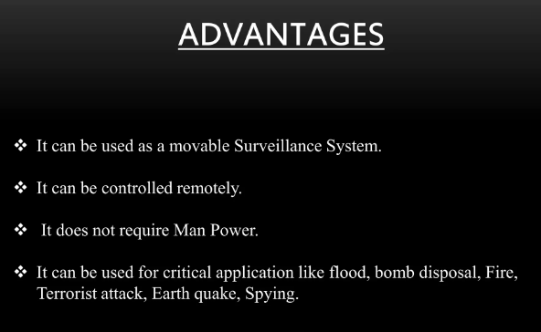
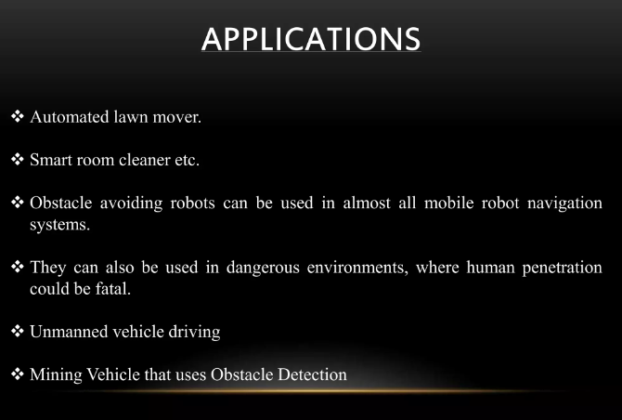
ADVANTAGES AND APPLICATIONS:

Slide 17
REFERENCES:
BOOKS:
D. Florcano and J: Urzelai. "Evolutionary Robots with Online Self-Organization and Behavioral Fitness“.
Oussama Khatib. "Real-Time Obstacle Avoidance for Manipulators and MobileRobots"
Marija Seder. "Hierarchical Path Planning of Mobile robots in Complex Indoor Environments“
WEBSITES:
http://en.wikipedia.org/wiki/Artificial_intelligence
http://science.howstuffworks.com/robot2.htm

Slide 18
CONCLUSION:
The goal of our project is to develop a surveillance bot controlled through a website and integrated with a camera module, representing a significant advancement in remote monitoring technology. This system provides seamless remote access and real-time surveillance capabilities while offering an adaptable solution for various sectors. It addresses critical requirements in security, safety, and operational efficiency. Furthermore, the project demonstrates the potential of modern remote surveillance systems in enhancing situational awareness and ensuring safer operations in challenging environments.

Slide 19
Thank You!!!

